Slide 1
AN PHU JUNIOR HIGH SCHOOL THU DUC CITY
OFFLINE ENGLISH TEACHING

Slide 2
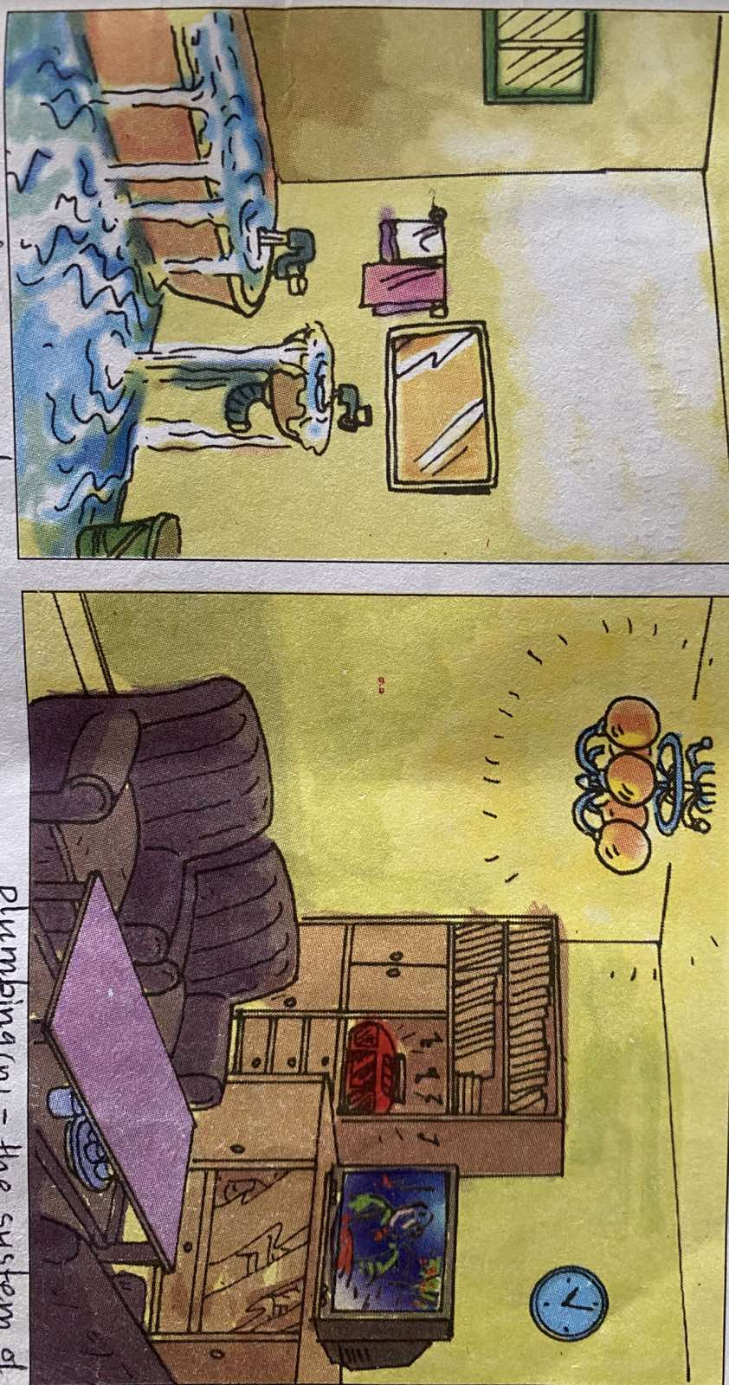
UNIT SEVEN SAVING ENERGY Lesson one
I. GETTING STARTED
Look at the pictures.
Make a list of things your family could do to save energy.

Slide 3
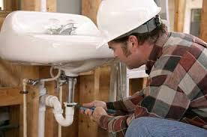
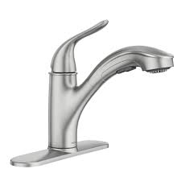
Fill in the blank in each sentence with the correct verbs below. (điền vào chổ trống trong mỗi câu, sử dụng các động bên dưới.)
Turn off (tắt thiết bị) –replace (thay thế)
get sb to do sth (nhờ ai làm gì) )
Take – remember
Take
a. _________________a shower instead of taking a bath.
b. ___________________ a plumber to repair burst water pipes.
c. ___________________ to turn off the faucets after using them.
d. ___________________ the lights and other electrical equipment before leaving.
e. _______________ normal light bulbs with energy-saving bulbs.
Get
Remember
Turn off
Replace

Slide 4
LISTEN AND READ
Read the conversation between Mrs. Mi and Mrs. Ha
in your textbook and then answer the questions:
(Đọc đoạn đối thoại giữa bà Mi và bà Hà, sau đó trả lời các câu hỏi.)
1. What is Mrs. Ha worried about? Why?
_________________________________________________
2. What are the three things Mrs. Ha should do to save water?
______________________________________________________
______________________________________________________
She is worried about her recent water bill. Because it is enormous.
She should get a plumber to make sure there are no cracks in the pipes, take showers instead of baths and remember to turn off the faucets.

Slide 5
Complete the following sentences, using the words in the conversation between Mrs. Mi and Mrs. Ha. ( Hoàn thành các câu sử dung từ trong đoạn đối thoại giữa bà Mi và bà Hà )
1. Mrs Ha’s most recent water ________________ is___________.
2. Mrs. Ha should reduce the_____________ of water her family uses.
3. Mrs. Mi advised Mrs. Ha to get a____________ to make sure there are no_____________ in the pipes.
4. A dripping __________can __________500 liters of water a month.
bill
enormous
amount
plumber
cracks
faucet
waste

Slide 6
Match the words in the 1st column to their meanings in the 2nd column. How do you say these words in Vietnamese? Copy the words in your notebook. (Nối các từ ở cột thứ nhất với nghĩa của chúng ở cột 2 và cho biết nghĩa tiếng việt của chúng. Chép các từ vào vở)
English | meanings | Vietnamese
1. bill (n) /bɪl/ 2. enormous (a) /ɪˈnɔː.məs/ 3. amount (n) /əˈmaʊnt/ 4. plumber (n) /ˈplʌm.ə r / 5. faucet (n) /ˈfɔː.sɪt/ 6. drip (v) /drɪp/ 7. crack (n) /kræk/ 8. waste (v) /weɪst/ | a. tap b. a quantity of sth c. a piece of paper that shows how much you have to pay for goods or services. d. use more of sth than is necessary e. extremely large, huge f. a line on the surface of sth where it has broken g. a person whose job is to supply and connect, or repair water pipes, baths, toilets, etc h. fall in small drops (giọt… nước) | 1. 2. 3. 4. 5. 6. 7. 8.
Hóa đơn
Lớn, nhiều
Số lượng
Thợ sửa
ống nước
Vòi nước
Nhỏ giọt
Vết nứt
Lãng phí

Slide 7
True or False? Check the boxes. Then correct the false statements. Đúng hay sai? Đánh dấu vào các khung . Sau đó sửa các câu sai.
TRUE
Mrs. Ha is worried about her water bill. _____
Mrs. Mi gives Mrs. Ha advice on how to save water. _____
Mrs. Ha checked the pipes in her house and found no cracks. _____
Mrs. Ha suggests getting some tool to check cracks in the pipes. _____
Mrs. Mi suggests taking showers to save water. ______
TRUE
FALSE
Mrs. Mi hasn’t checked the pipes, but she will get a plumber to do it.
FALSE
Mrs. Mi suggests getting a plumber to make sure there are no cracks in the pipes.
TRUE

Slide 8
Put the following words in the correct column according to their parts of speech. Then copy them in your notebook. (Đặt các từ dưới đây vào đúng cột dựa theo từ loại. Sau đó chép chúng vào vở)
energy, energetic, energize, energetically,
enormous, enormously
reduce, reduction, irreducible
suggest, suggestion, suggestive
drip, drop
waste, wasteful, wastefully
VERB | NOUN | ADJECTIVE | ADVERB
1.
2.
3.
4.
5.
6.
energize
energy
energetic
energetically
enormous
enormously
reduce
reduction
irreducible
suggest
suggestion
suggestive
drip
drop
waste
waste
wasteful
wastefully

Slide 9
Fill in the blank in each sentence with the correct form of the word in brackets.
He's very ________________for a man of his age, isn't he? (energy)
The show was ________________popular. (enormous)
Guests staying 14 nights will receive a 10%_____________. (reduce)
There were little ______________of paint on the kitchen floor. (drip)
The water shortage is due to _______________consumption during a period of drought.(waste)
energetic
enormously
reduction
drops
wasteful

Slide 10
HOMEWORK
Learn by heart all new words in lesson one.
Make one sentence with each new word.
Make a list of things you can do to save water, electricity. (use your own words.)

Slide 11
THIS IS THE END OF LESSON ONE

